Slide 1
Discrete Mathematics
Lecture 1

Slide 2
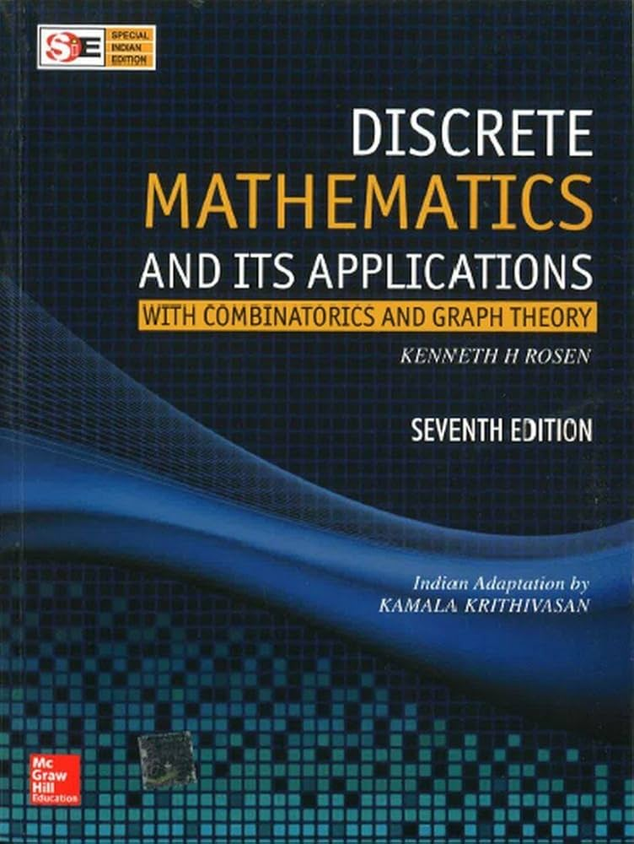
Textbook:

Slide 3
Reference Books
Rosen K.H, Discrete Mathematics and its Application, 5th Edition, Mcgraw Hill Co. Inc., 2012.
Johnonbaugh R., Discrete Mathematics,
6th Edition, Prentice Hall, 2004.
3.Susanna S. E, Discrete Mathematics with Applications, 3rd Edition, Thomson, 2004.

Slide 4
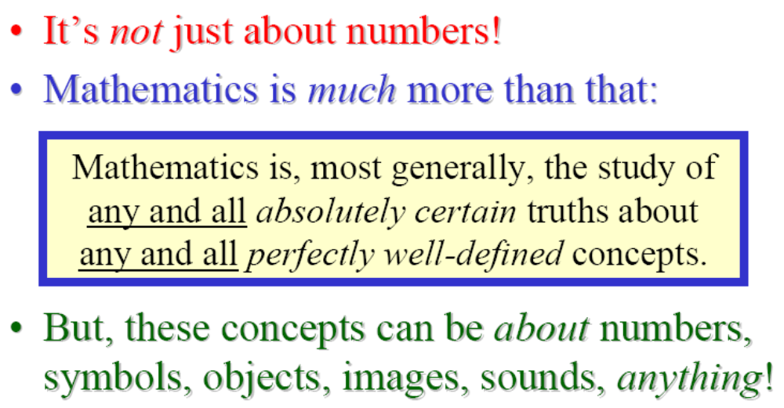
What is Mathematics, really?

Slide 5
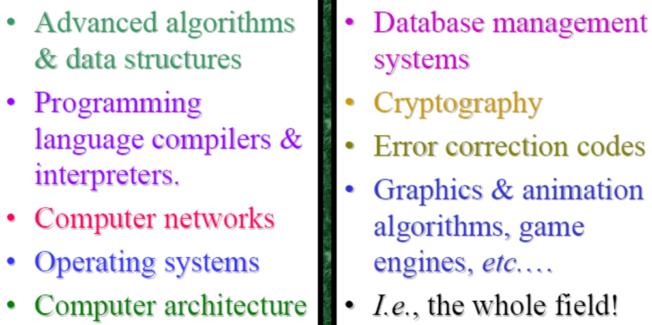
Uses for Discrete Math in Computer Science

Slide 6
Course objectives
After completing this course:
➢ Students will express real-life concepts and mathematics; know set operation analogues.
➢Students will know basic methods of proofs and use certain basic strategies to produce proofs; have a notion of mathematics as an evolving subject.
➢Students will be comfortable with various forms of induction and recursion.
➢Students will understand algorithms and time complexity from a mathematical viewpoint.
➢Students will know a certain amount about: Boolean Algebra, functions, number theory, counting, Discrete probability distributions and equivalence relations.

Slide 7
Tentative Topics
Sets and their properties
Algorithm and Complexity of Functions
Sequences, Summations, and Recursive Algorithm
Integers, Divisions, and Applications of Number theory
Concepts of Counting, Discrete probability functions,
Random walk, Markov chains
Relations, and their properties
Boolean functions and their representation, Logic gates, Minimization of circuits, etc.

Slide 8
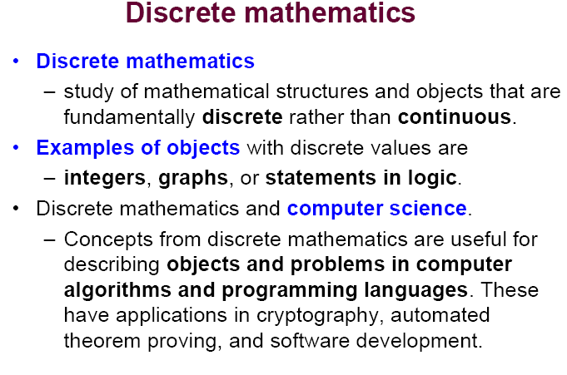

Slide 9
Course Overview and
Introduction

Slide 10
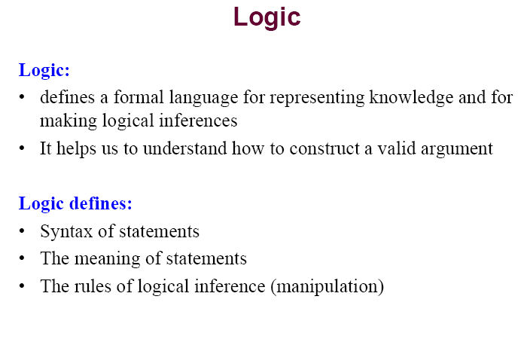

Slide 11
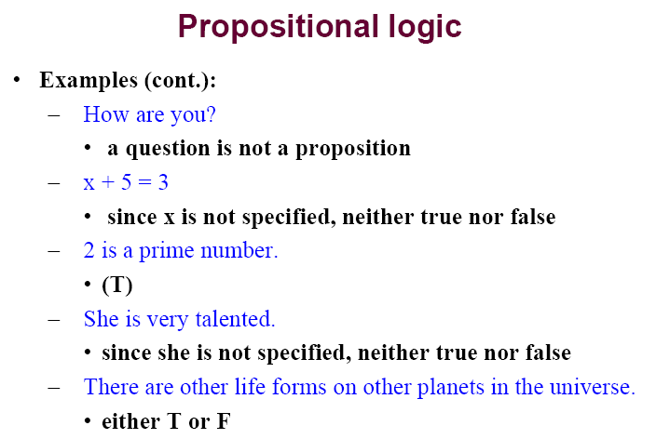

Slide 12
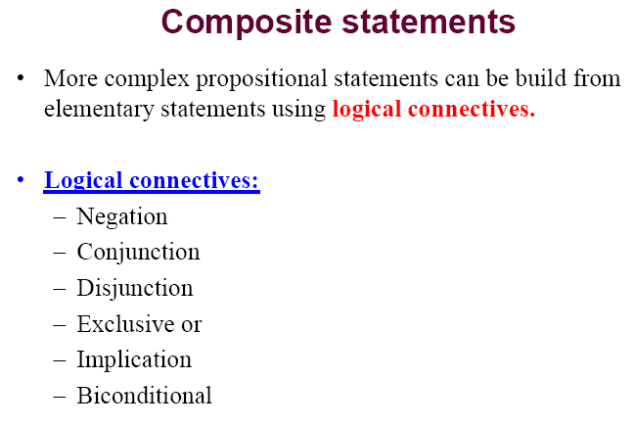

Slide 13
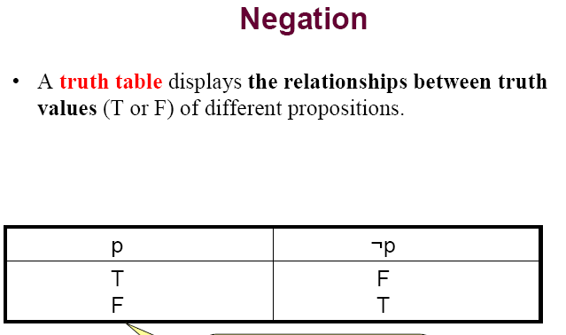

Slide 14
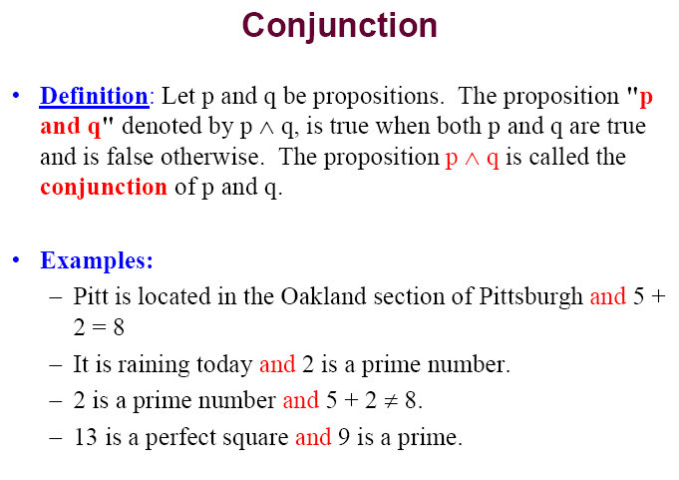

Slide 15
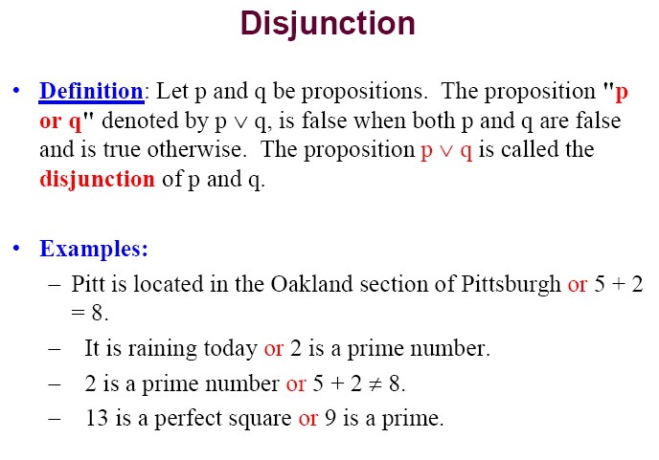

Slide 16
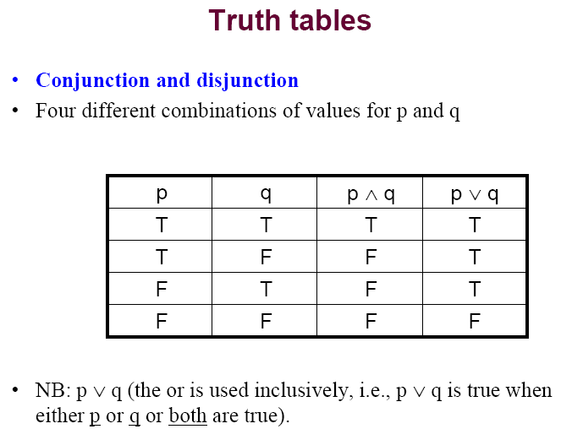

Slide 17
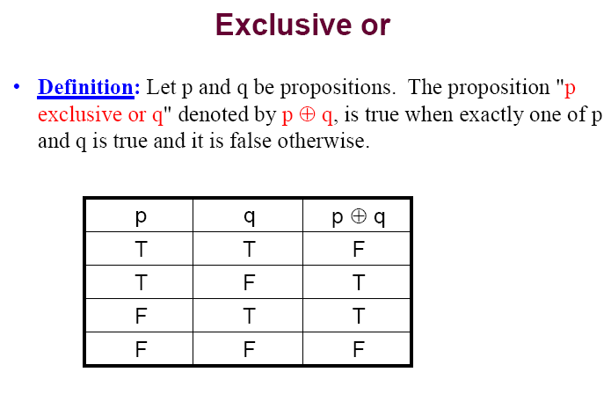

Slide 18
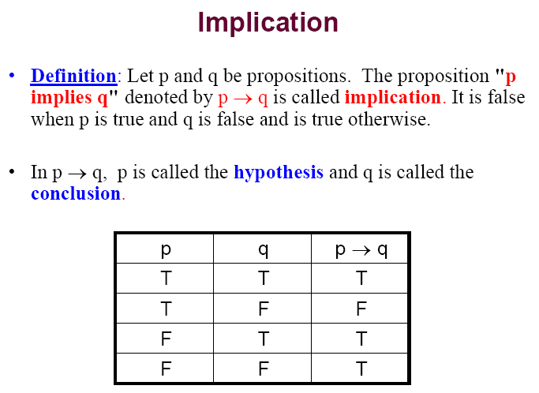

Slide 19
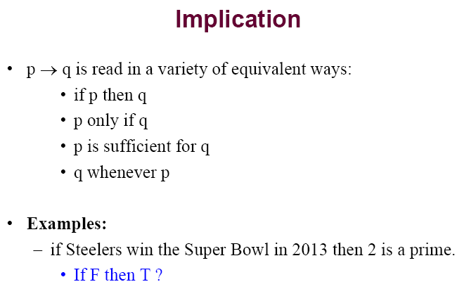

Slide 20
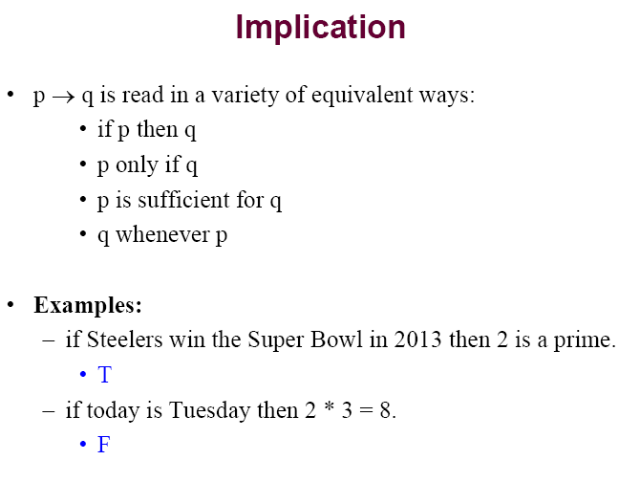

Slide 21
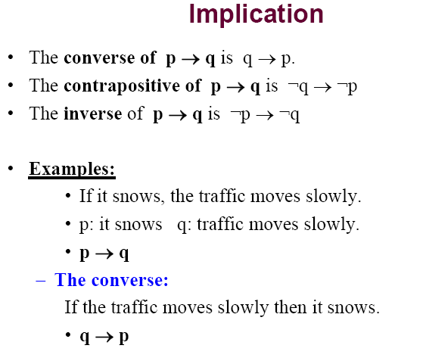

Slide 22
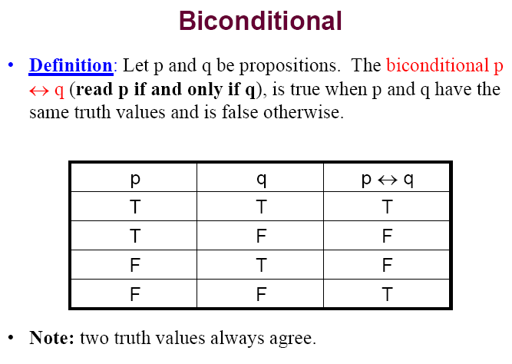

Slide 23
Logical Equivalence
When two compound propositions always have same truth values, they are called logically equivalent
p → q and ¬ p ∨ q are logically equivalent
Truth tables are the simplest way to prove such facts.
Converse
Converse of p → q is q → p

Slide 24
Contrapositive
Contrapositive of p → q is ¬q → ¬p
Any conditional and its contrapositive are logically equivalent (have the same truth table
E.g. The contrapositive of “If you get 100% in this course, you will get an A+” is “If you do not get an A+ in this course, you did not get 100%”.

Slide 25
Other conditionals
Inverse:
inverse of p → q is ¬p → ¬q
How is this related to the converse?
Biconditional:
“If and only if”
True if p,q have same truth values, false otherwise. Q: How is this related to XOR?
Can also be defined as (p → q) ∧ (q → p)

Slide 26
Some Popular Boolean Operators
Formal Name | Nickname | Arity | Symbol
Negation operator | NOT | Unary | ¬
Conjunction operator | AND | Binary | ∧
Disjunction operator | OR | Binary | ∨
Exclusive-OR operator | XOR | Binary | ⊕
Implication operator | IMPLIES | Binary | →
Biconditional operator | IFF | Binary | ↔

Slide 27
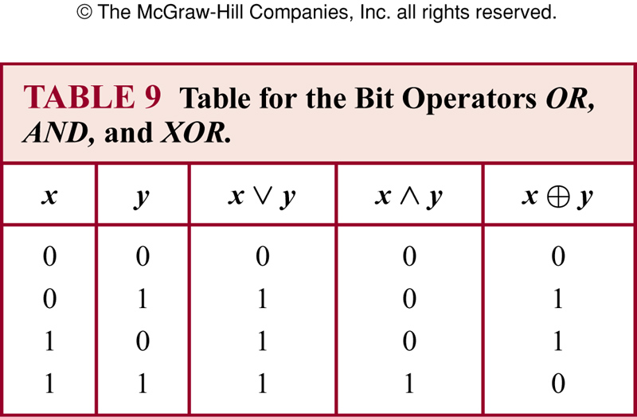
Bit operations

Slide 28
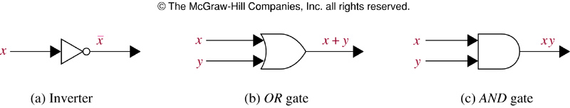
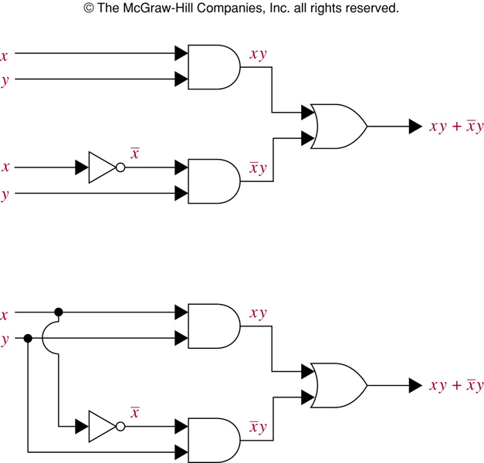
Logic gates

